Slide 1




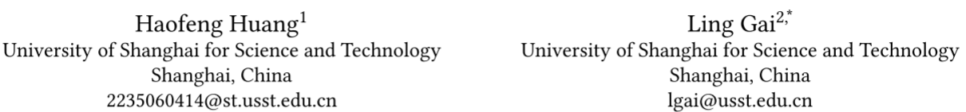





ATAI
Advanced Technique of Artificial Intelligence
ATAI
ChongqingUniversity _{AdvancedTechniqueof}
of Technology Artificial Intelligence
Chongqing University of Technology
Chongqing University ^{ATAI}
_{of Technology} Advanced Techniqueof
Artificial Intelligence
Chongqing University of Technology
Chongqing University of Technology
Q-BERT4Rec: Quantized Semantic-ID Representation Learning
for Multimodal Recommendation
code: None
—— KDD ’26
Reported by Junsi Chen
1

Slide 2

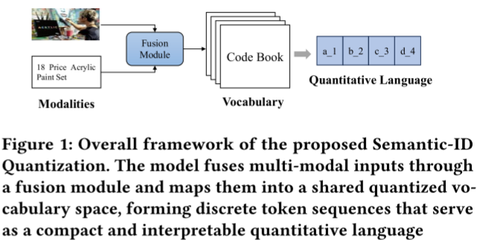
ATAI
AdvancedTechniqueof
Artificial Intelligence
ATAI
ChongqingUniversity _{AdvancedTechniqueof}
of Technology Artificial Intelligence
ChongqingUniversity of Technology
Motivation
(1) Existing models either perform static multimodal fusion without adaptivity, or decouple quantization from sequence modeling, thereby limiting both interpretability and generalization.
(2) Traditional sequential recommenders represent items as discrete and meaningless IDs, which lack semantic understanding and hinder generalization across domains.

Slide 3

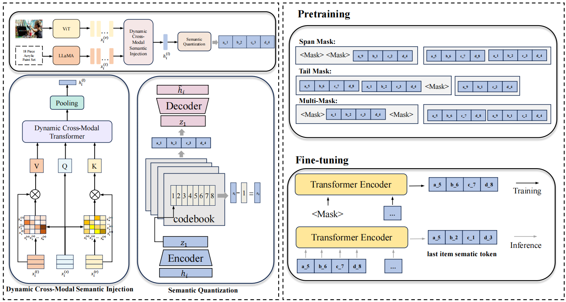
ChongqingUniversity of Technology
ATAI
AdvancedTechniqueof
Artificial Intelligence
ATAI
ChongqingUniversity _{AdvancedTechniqueof}
of Technology Artificial Intelligence
Overview

Slide 4


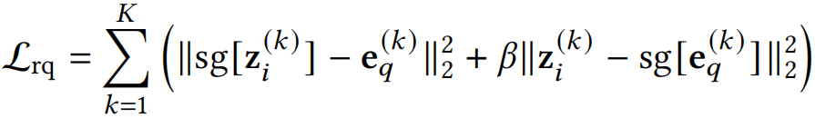
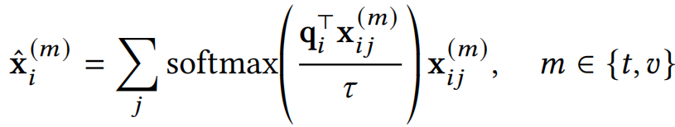




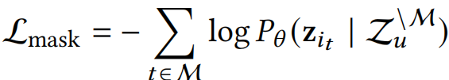
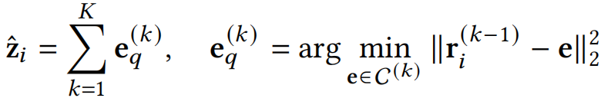
ChongqingUniversity of Technology
ATAI
AdvancedTechniqueof
Artificial Intelligence
ATAI
ChongqingUniversity _{AdvancedTechniqueof}
of Technology Artificial Intelligence
Method
(1)
(7)
(2)
(8)
(3)
(9)
(4)
(10)
(5)
(11)
(6)

Slide 5

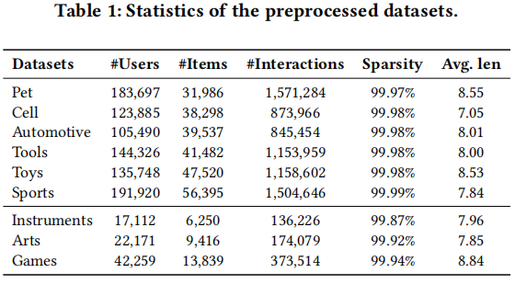
ATAI
Advanced Technique of Artificial Intelligence
ATAI
ChongqingUniversity _{AdvancedTechniqueof}
of Technology Artificial Intelligence
Chongqing University of
Technology
Chongqing University ^{ATAI}
_{of Technology} Advanced Techniqueof
Artificial Intelligence
Chongqing University of Technology
Chongqing University of Technology

Slide 6
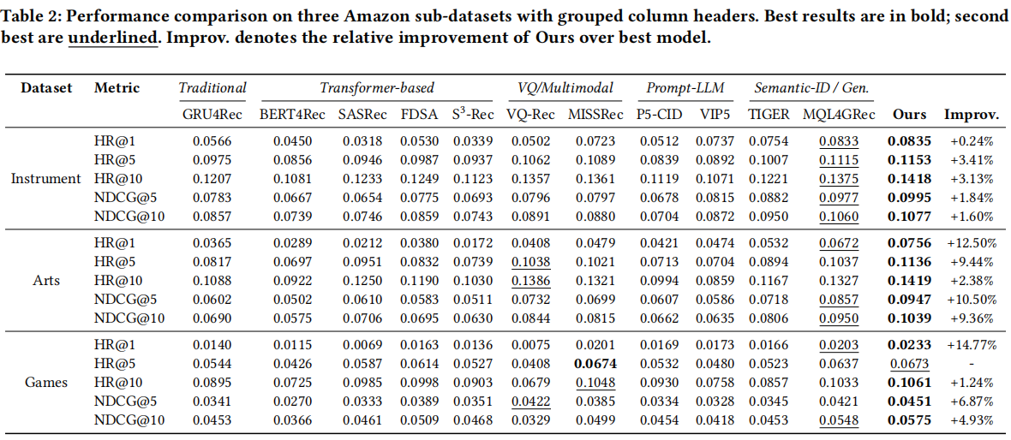
ATAI
Advanced Technique of Artificial Intelligence
ATAI
ChongqingUniversity _{AdvancedTechniqueof}
of Technology Artificial Intelligence
Chongqing University of
Technology
Chongqing University ^{ATAI}
_{of Technology} Advanced Techniqueof
Artificial Intelligence
Chongqing University of Technology
Chongqing University of Technology

Slide 7
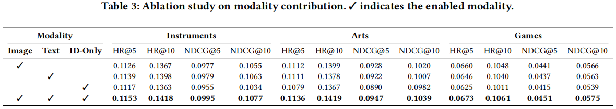
ATAI
Advanced Technique of Artificial Intelligence
ATAI
ChongqingUniversity _{AdvancedTechniqueof}
of Technology Artificial Intelligence
Chongqing University of
Technology
Chongqing University ^{ATAI}
_{of Technology} Advanced Techniqueof
Artificial Intelligence
Chongqing University of Technology
Chongqing University of Technology

Slide 8
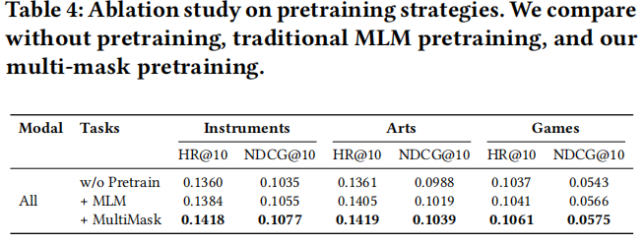
ATAI
Advanced Technique of Artificial Intelligence
ATAI
ChongqingUniversity _{AdvancedTechniqueof}
of Technology Artificial Intelligence
Chongqing University of
Technology
Chongqing University ^{ATAI}
_{of Technology} Advanced Techniqueof
Artificial Intelligence
Chongqing University of Technology
Chongqing University of Technology

Slide 9
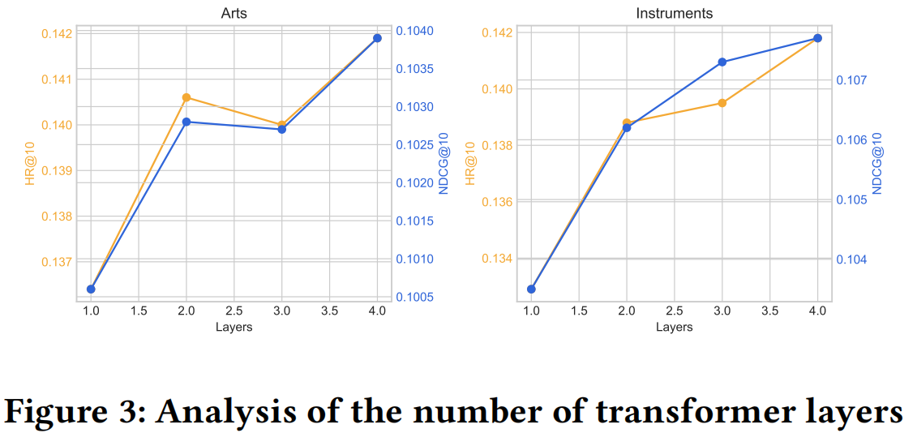
ATAI
Advanced Technique of Artificial Intelligence
ATAI
ChongqingUniversity _{AdvancedTechniqueof}
of Technology Artificial Intelligence
Chongqing University of
Technology
Chongqing University ^{ATAI}
_{of Technology} Advanced Techniqueof
Artificial Intelligence
Chongqing University of Technology
Chongqing University of Technology

Slide 10
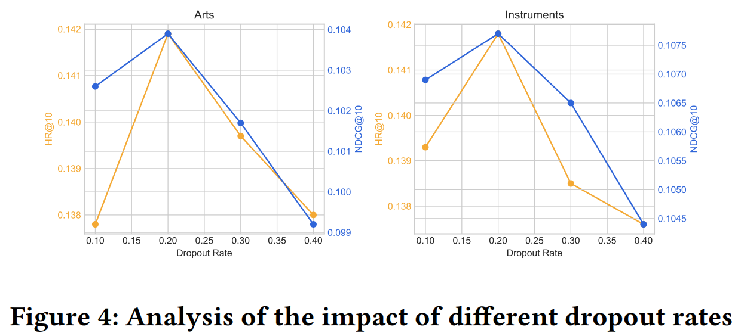
ATAI
Advanced Technique of Artificial Intelligence
ATAI
ChongqingUniversity _{AdvancedTechniqueof}
of Technology Artificial Intelligence
Chongqing University of
Technology
Chongqing University ^{ATAI}
_{of Technology} Advanced Techniqueof
Artificial Intelligence
Chongqing University of Technology
Chongqing University of Technology

Slide 11
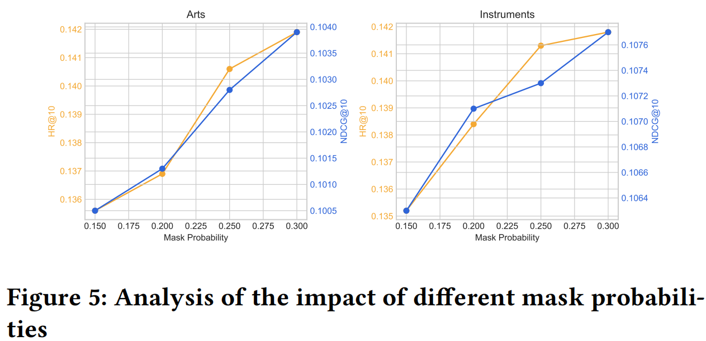
ATAI
Advanced Technique of Artificial Intelligence
ATAI
ChongqingUniversity _{AdvancedTechniqueof}
of Technology Artificial Intelligence
Chongqing University of
Technology
Chongqing University ^{ATAI}
_{of Technology} Advanced Techniqueof
Artificial Intelligence
Chongqing University of Technology
Chongqing University of Technology

Slide 12
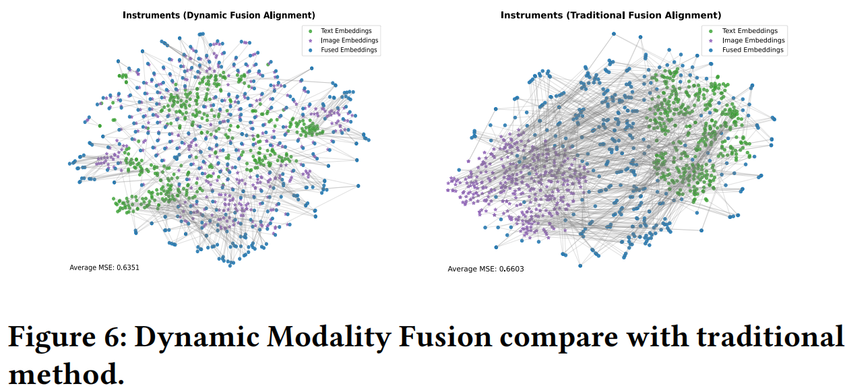
ATAI
Advanced Technique of Artificial Intelligence
ATAI
ChongqingUniversity _{AdvancedTechniqueof}
of Technology Artificial Intelligence
Chongqing University of
Technology
Chongqing University ^{ATAI}
_{of Technology} Advanced Techniqueof
Artificial Intelligence
Chongqing University of Technology
Chongqing University of Technology

Slide 13
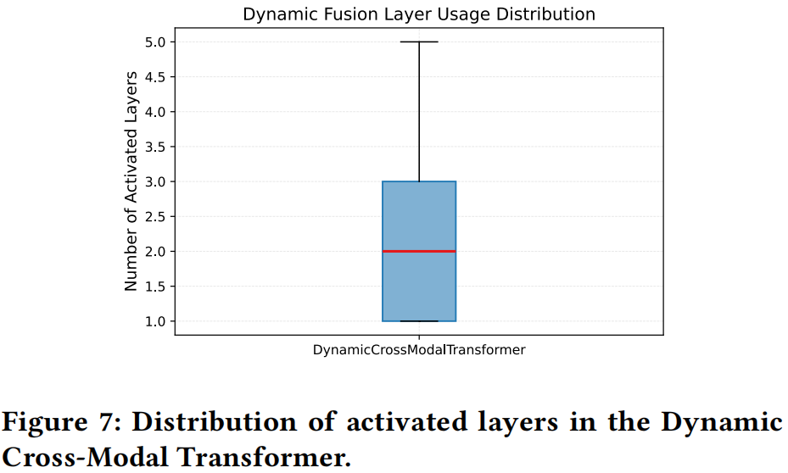
ATAI
Advanced Technique of Artificial Intelligence
ATAI
ChongqingUniversity _{AdvancedTechniqueof}
of Technology Artificial Intelligence
Chongqing University of
Technology
Chongqing University ^{ATAI}
_{of Technology} Advanced Techniqueof
Artificial Intelligence
Chongqing University of Technology
Chongqing University of Technology

Slide 14


ATAI
Advanced Technique of
Artificial Intelligence
ATAI
ChongqingUniversity _{AdvancedTechniqueof}
of Technology Artificial Intelligence
Chongqing University of Technology
Thanks!

